Slide 1
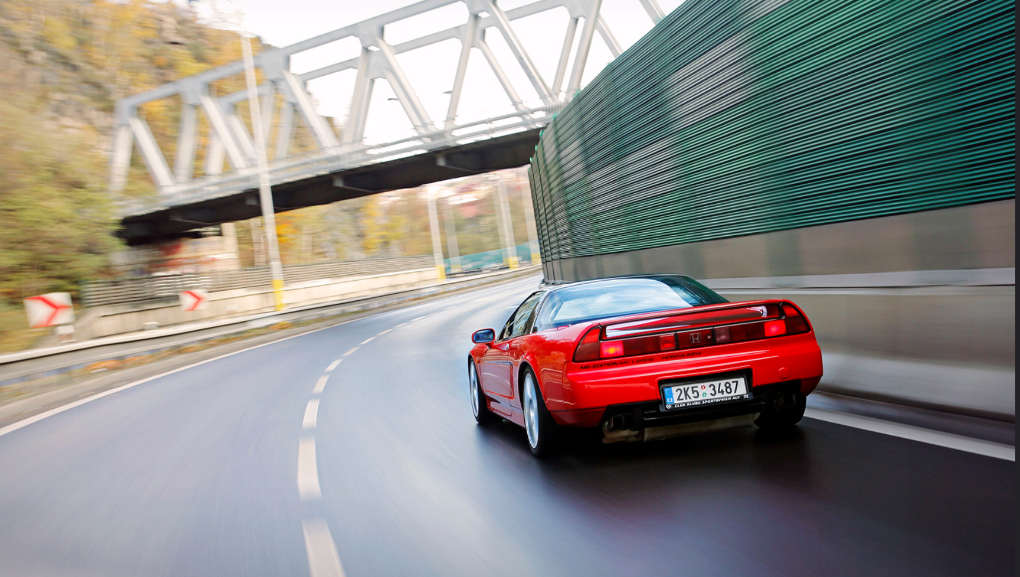
Our Dream is Here
Team 2SI1ME
Sai | Pradeep | Yunyy
Notes:
Sai

Slide 2

Our Team
Yunny
Grad Student
MSI
Pradeep
Grad Student
ME
Mumbai, India 🇮🇳
Sai Sur
Junior
BSI
Qatar 🇶🇦 + India 🇮🇳
Notes:
Fun Fact We are all Transfer Students from
West Coast,
East Coast
and
Midwest
Our First Semester Here!!!
Fun Fact We are all Transfer Students from
West Coast,
East Coast
and
Midwest
Our First Semester Here!!!
Fun Fact We are all Transfer Students from
West Coast,
East Coast
and
Midwest
Our First Semester Here!!!

Slide 3
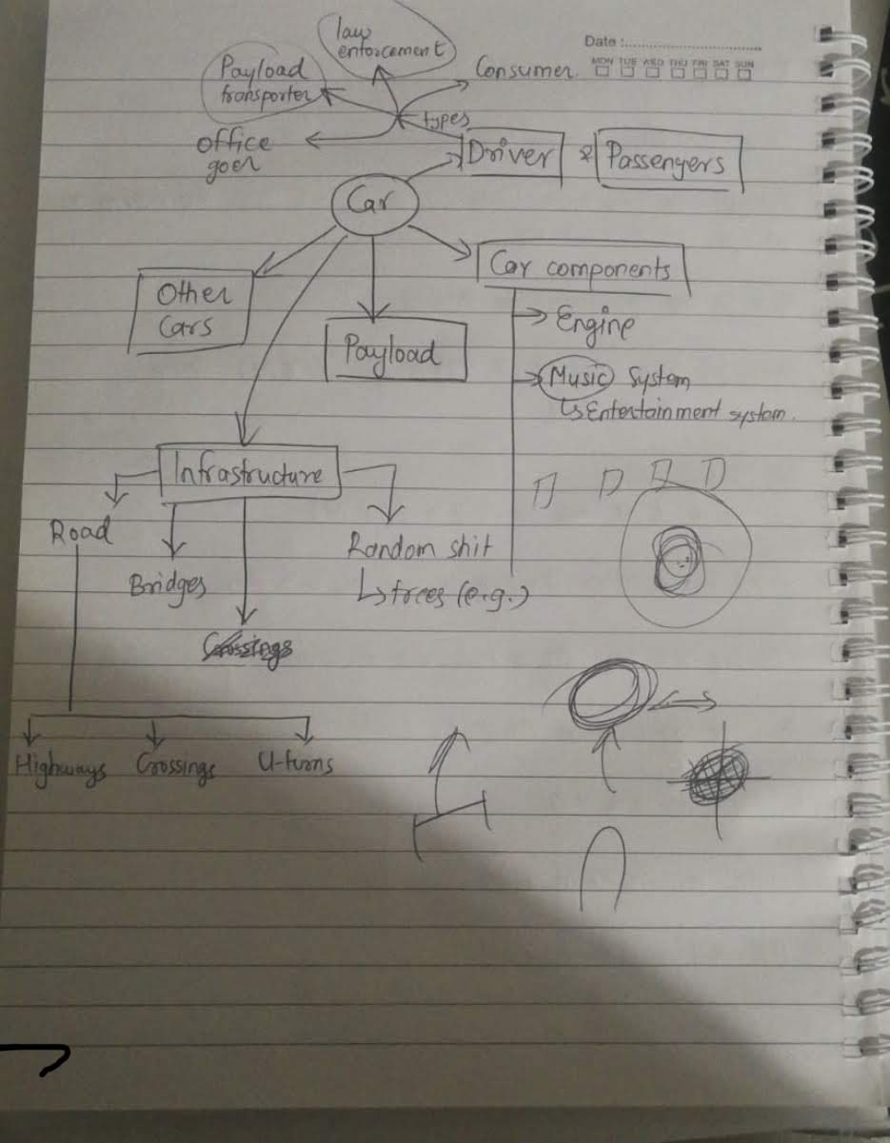
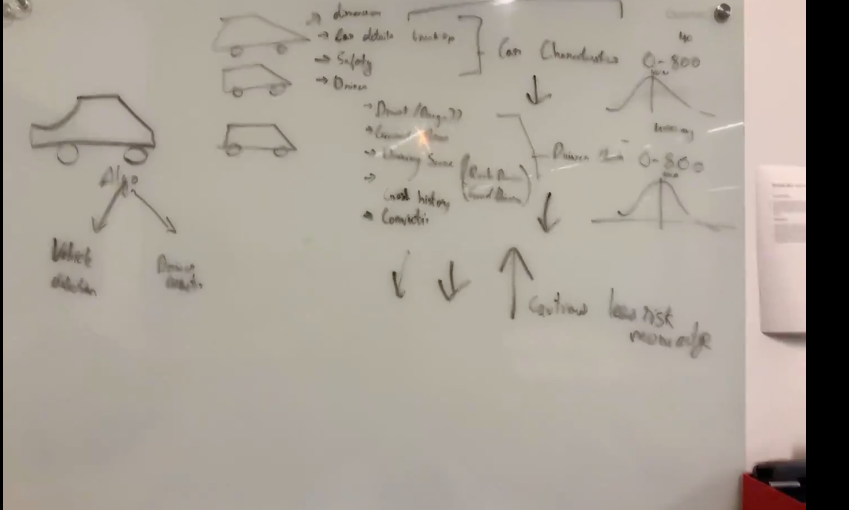
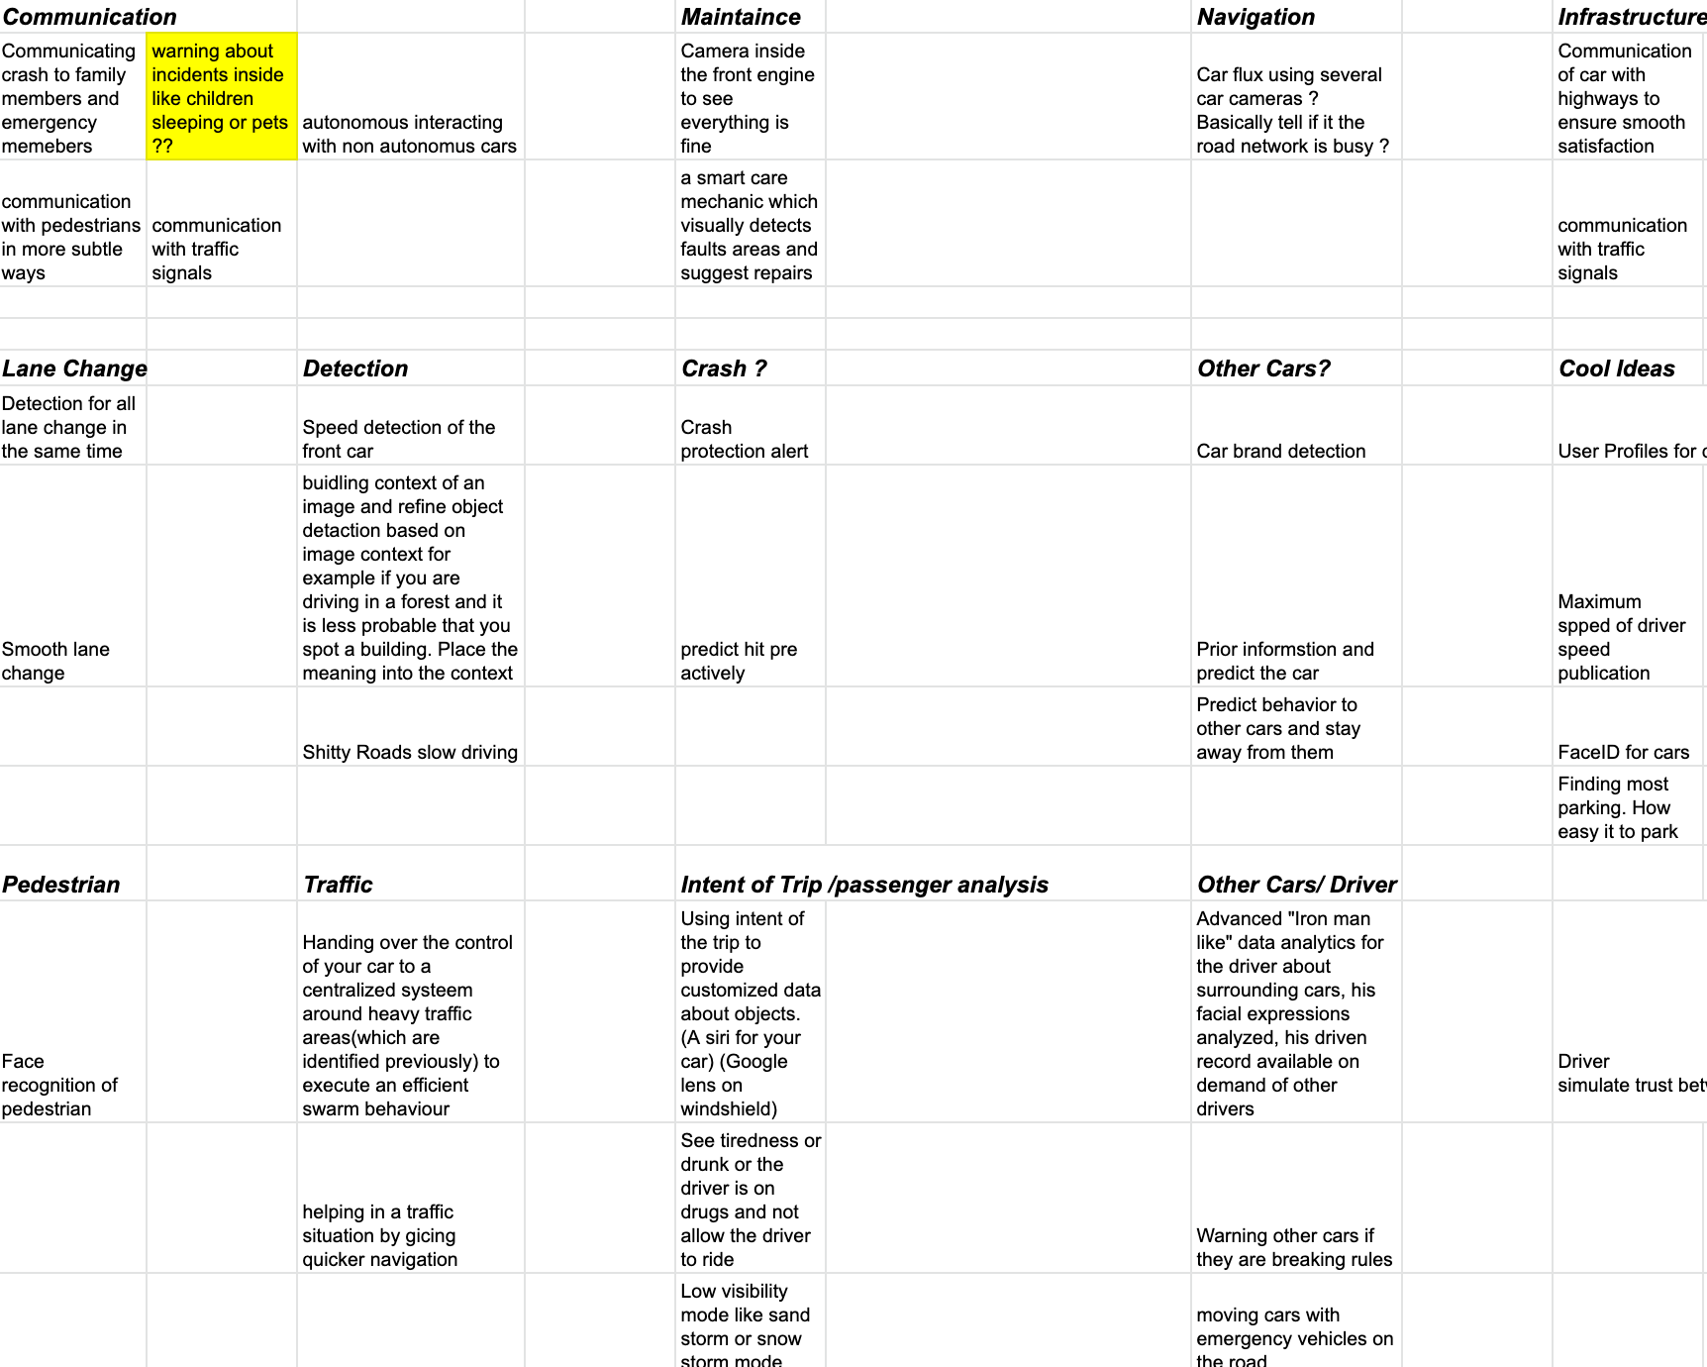
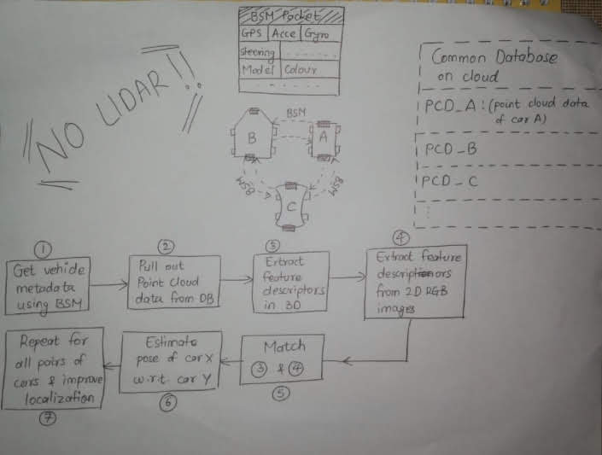
Ideation

Slide 4

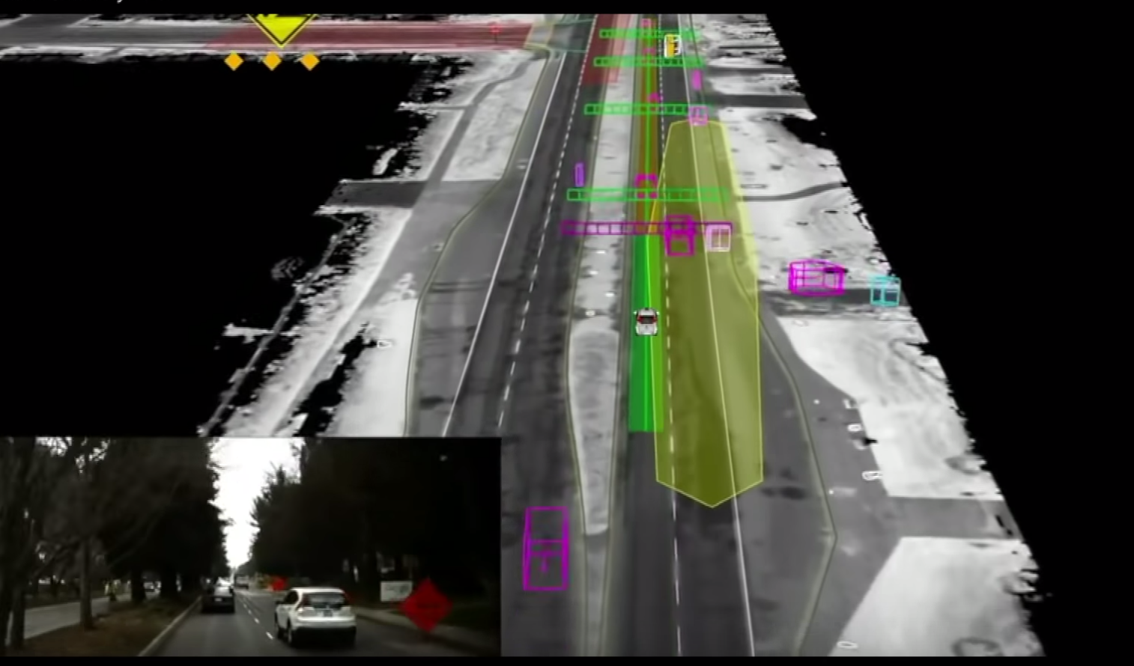
Notes:
This got us thinking “How do we make it quicker to detect realt”

Slide 5
Opportunities
Error from 1 to 10 meters through GPS.
Localisation through Matching is not cost effective
Reckless Driving is the 4th largest reason for Car Fatalities in the US where 46% of drivers were driving straight before
Pose Estimation will allow drivers to navigate through
tricky situations
https://crashstats.nhtsa.dot.gov/Api/Public/ViewPublication/811059
JOURNEY | SOLUTION | IMPLEMENTATION | IMPACT
SWOT ANALYSIS | INCENTIVES | SOLUTION | FINANCIALS | IMPLEMENTATION | CONCLUSION
Notes:
Miles

Slide 6
Chasing the 9s
How do we localize
information for greater
Localization and Position accuracy
with BSM information and identification of Cars
Notes:
Localisation of the car behind and forward of him. Exact location

Slide 7
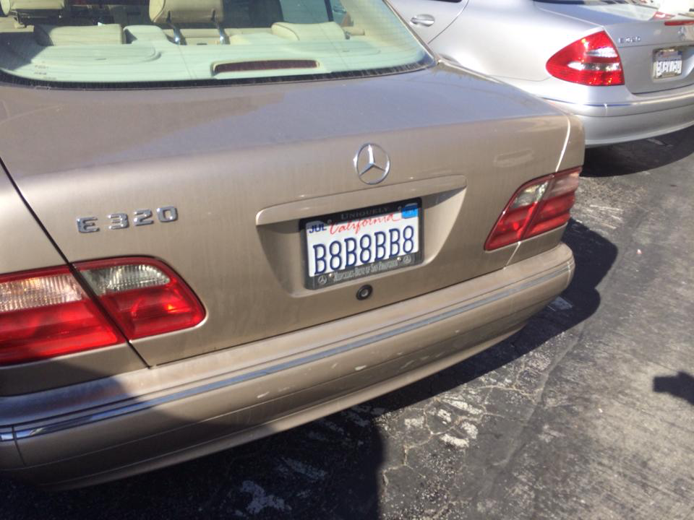
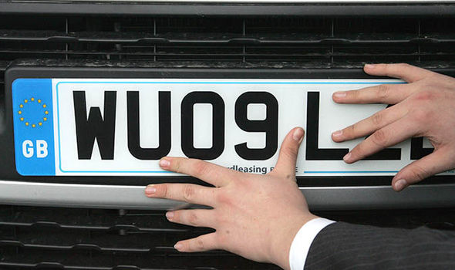
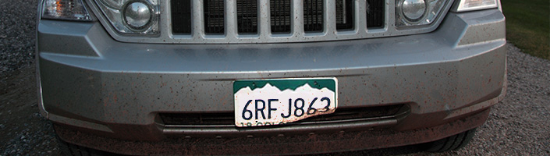
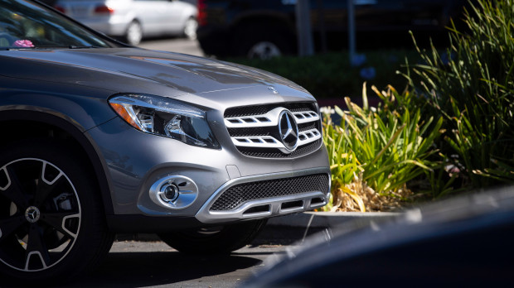
Traditional Method
Automated License Plate Recognition
License Plate can be damaged and ambiguous
Difficulty in terms of interpreting letters (e.g., between “0” and “O”) or license types
Michigan! No license plates in the front
JOURNEY | SOLUTION | IMPLEMENTATION | IMPACT
SWOT ANALYSIS | INCENTIVES | SOLUTION | FINANCIALS | IMPLEMENTATION | CONCLUSION
Notes:
Bree

Slide 8

Information Gathering
Our Idea
Implementation
Analysis
Pose Estimation

Slide 9
Information Gathering
BSM
All vehicles receive the Broadcast BSMs when they reach a particular zone
Using the BSM, parse put “supposed” xyz coordinates of the features of the car model
{
“Car Number Plate”: ”ABGYN”,
“GPS” : [42.335043, -83.075244],
“Acceleration” : 4 m/s^2,
“Gyroscope Values” : [0.01, 1.02, 1.33]
“Model” : “Honda Civic 2016 SI”,
“Color”: “Red”
“Bumper modification”: “Yes”
}
JOURNEY | SOLUTION | IMPLEMENTATION | IMPACT
SWOT ANALYSIS | INCENTIVES | SOLUTION | FINANCIALS | IMPLEMENTATION | CONCLUSION
Notes:
Bree

Slide 11
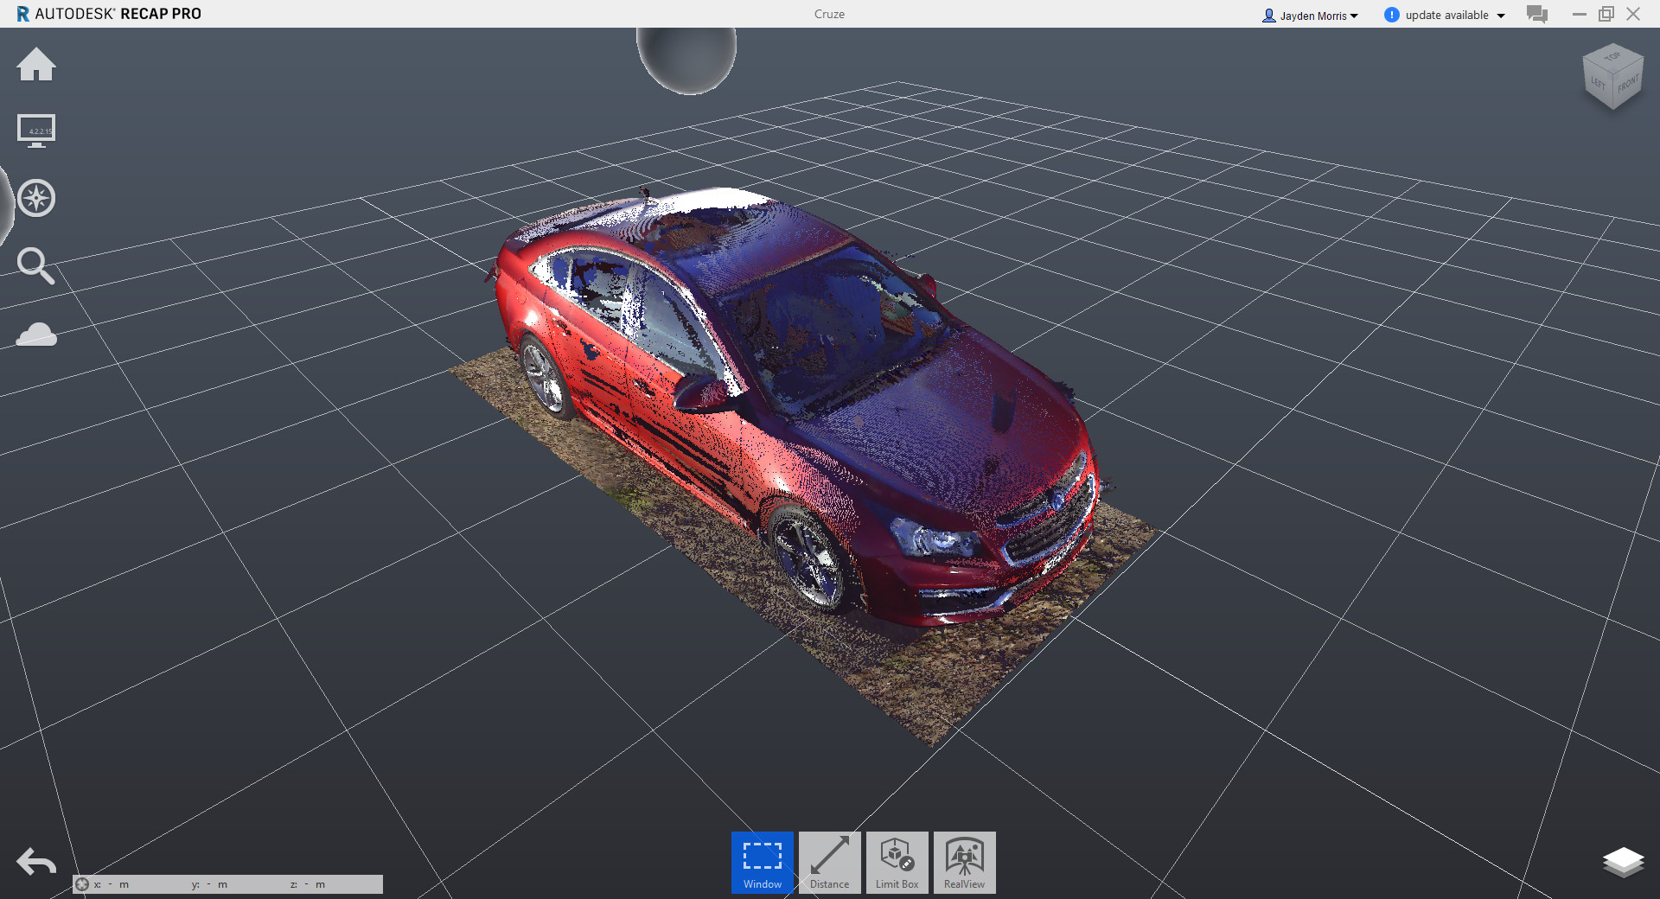
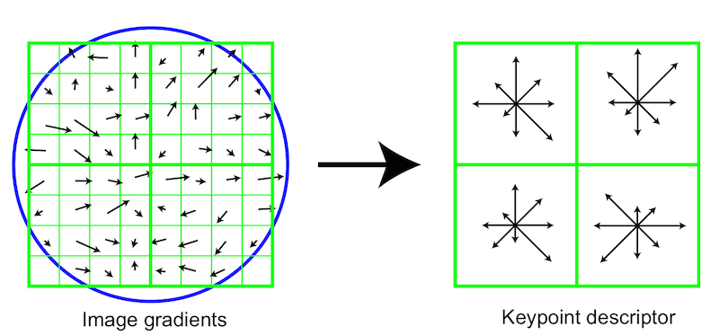
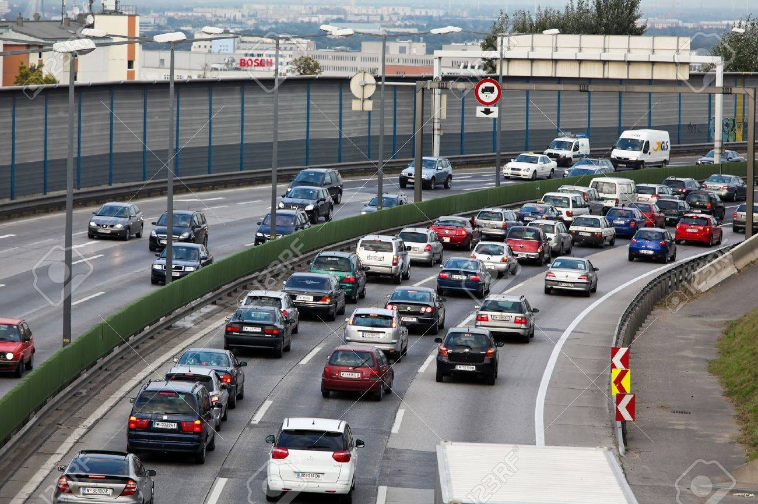
Analysis
Point Cloud
Feature Description
Repeat Process for all Cars
Extract feature descriptions in 3D
Extract feature descriptions from 2D RGB images by the cameras
Pull out the point cloud data after receiving the BSM
Assuming good internet connection
JOURNEY | SOLUTION | IMPLEMENTATION | IMPACT
SWOT ANALYSIS | INCENTIVES | SOLUTION | FINANCIALS | IMPLEMENTATION | CONCLUSION
Notes:
Bree

Slide 12
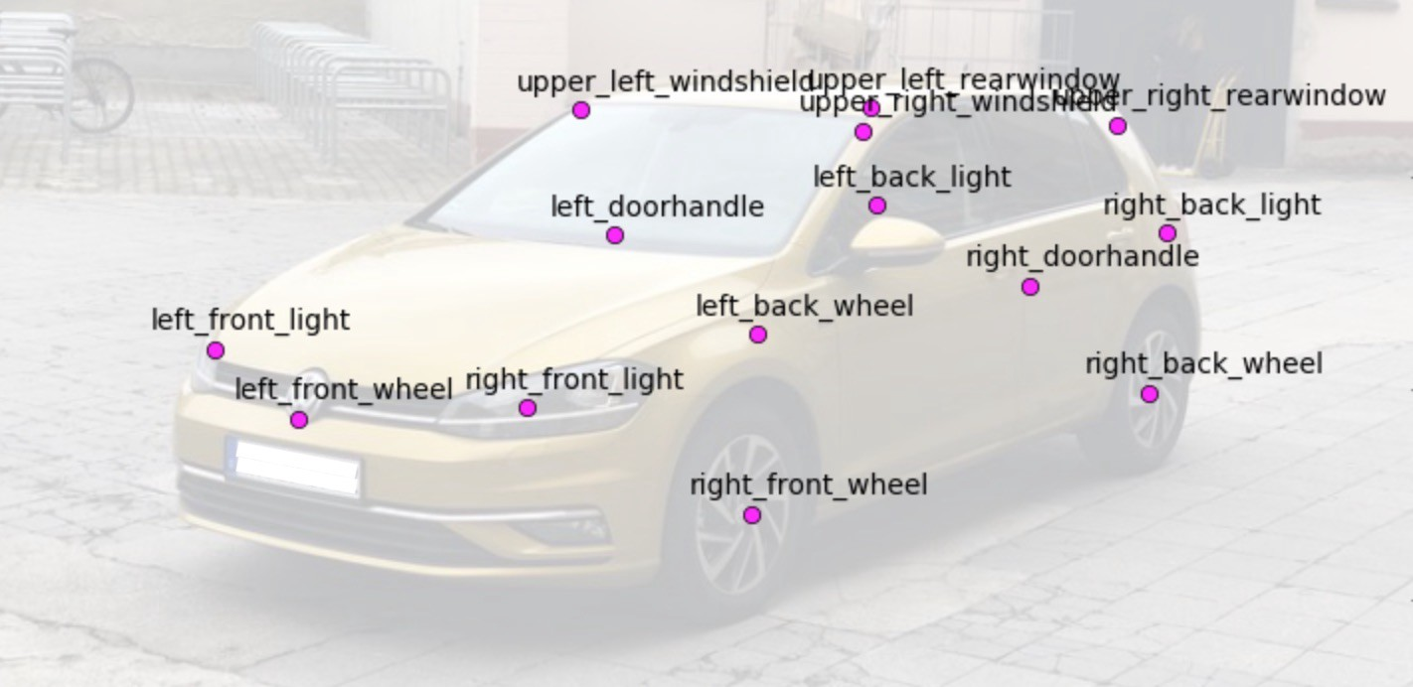
Pose Estimation
Tracking the position and orientation of the car with respect to the camera using the PnP-Ransac.
Using the 3d model information to locate a point in 3d world with respect to some coordinate axis.
Using the image captured by our camera, to extract the coordinates of some specific features.
These features are mainly corners of the car , special contours and attachments of the car
Repeat the process for all cars
JOURNEY | SOLUTION | IMPLEMENTATION | IMPACT
SWOT ANALYSIS | INCENTIVES | SOLUTION | FINANCIALS | IMPLEMENTATION | CONCLUSION
Notes:
Bree

Slide 13
Demo
Notes:
Localisation of the car behind and forward of him. Exact location

Slide 14




Implementation
Pilot Phase
Identify
Plan
Implement
Evaluate
Single User
Evolution
Internal audits
Update for new tactics and ideas
Onboarding
Scale up
Study to Time-Sensitive Materials

Slide 15
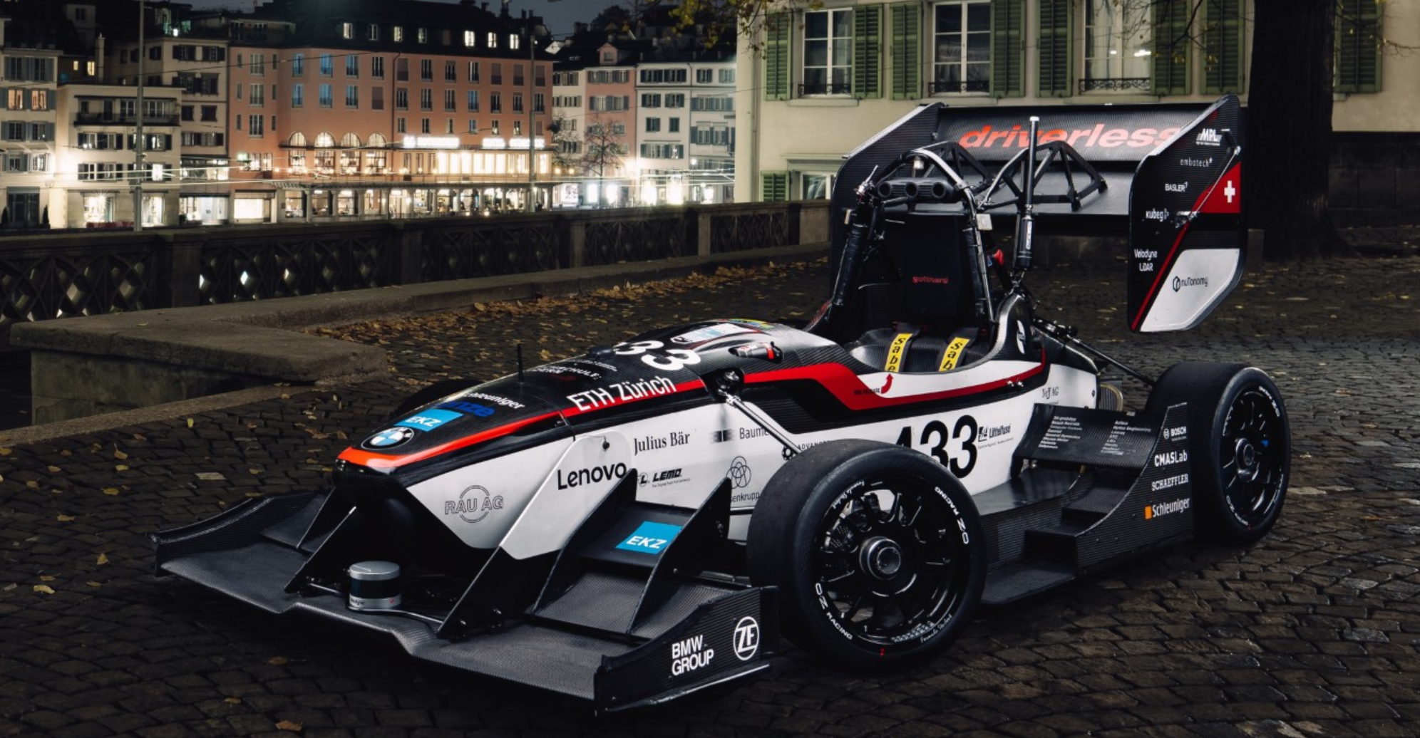
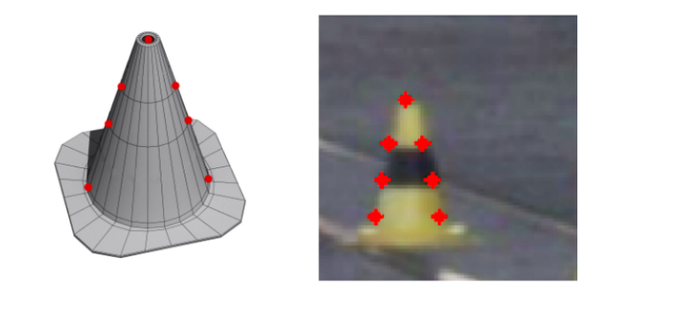
AMZ team at ETH Zurich working on the same challenges of the autonomous vehicles for street races using Real-time 3D Pose Estimation with a Monocular Camera Using Deep Learning and Object Priors
Tried estimating the traffic cones and edges of racetrack using the 3d model of race-track and cones
Doesn’t track any moving objects.

Slide 16
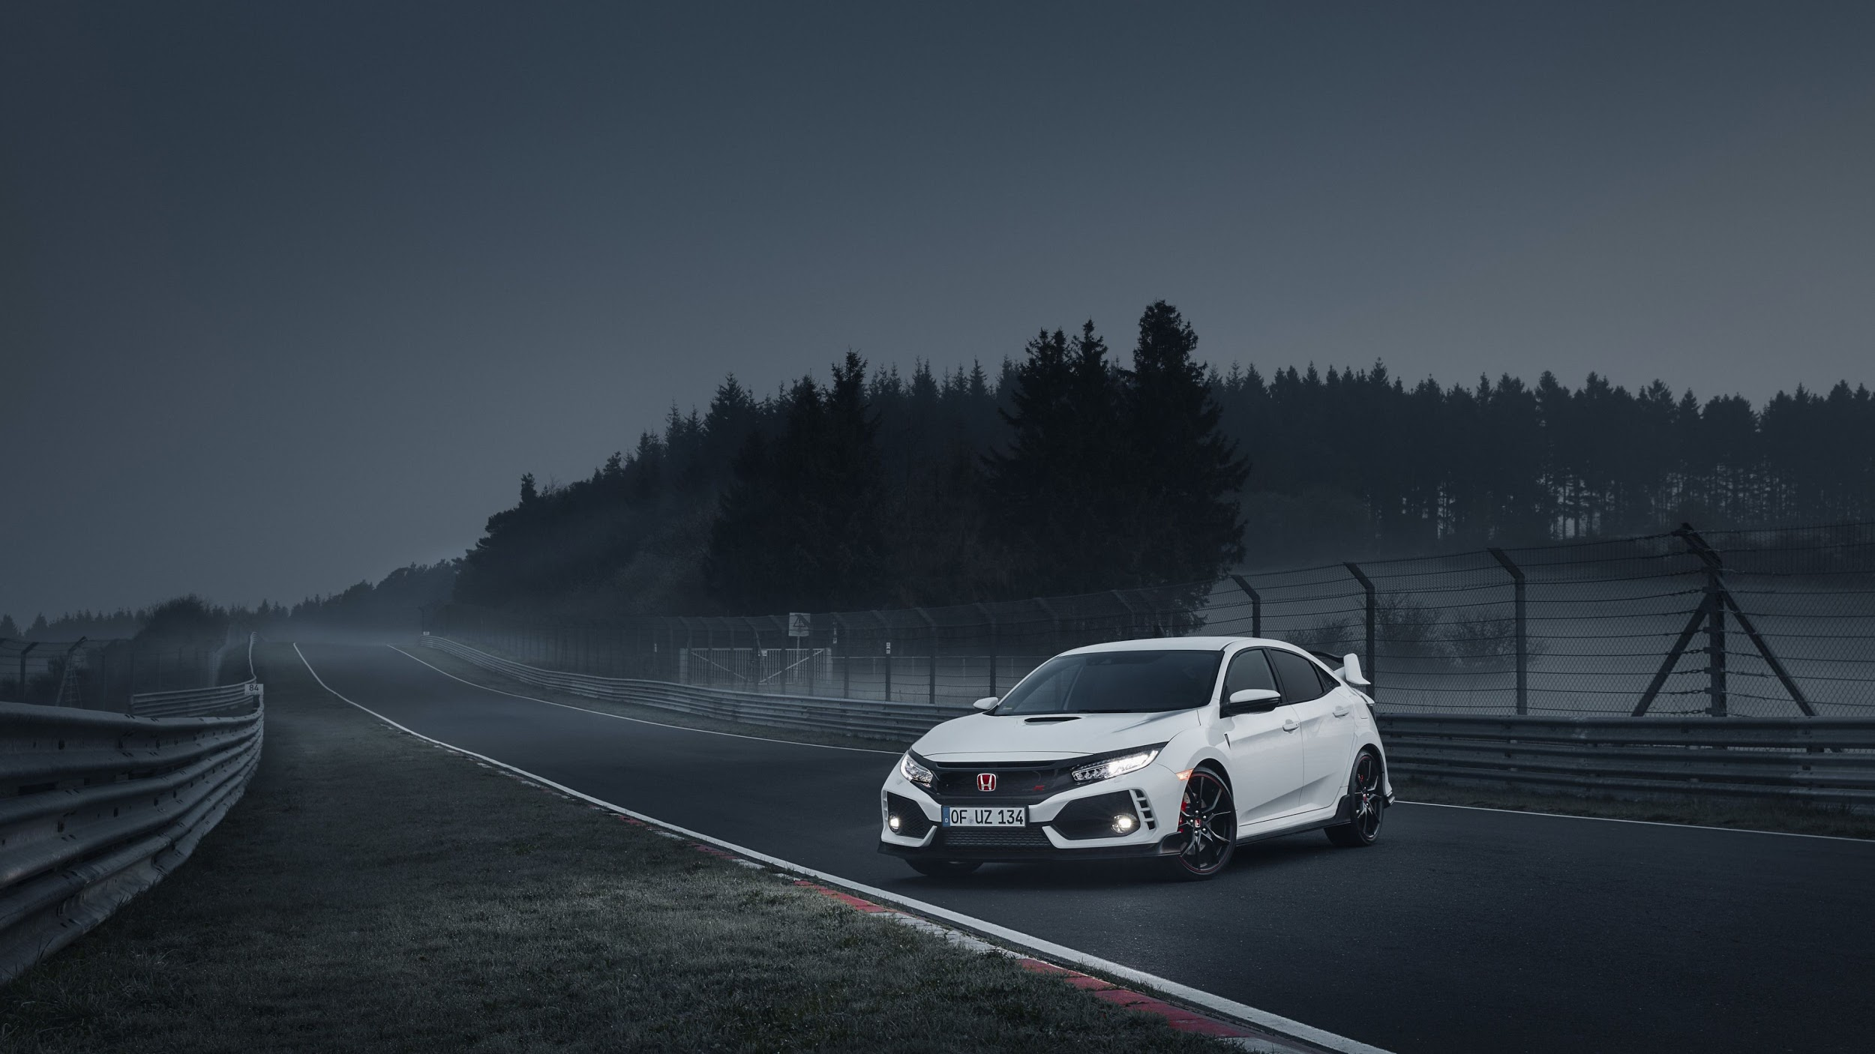
Conclusion
We plan to reimagine the way cars localize
information for greater
accuracy and triangulate data
Do you want to be part of this Dream ?
Notes:
To wrap things up, the benefits that blockchain technology provides are simply too great to pass up. Out of all of the available providers, we believe that CargoSmart is the best option for NWSA because of its high growth network opportunity and potential for a NPV and cost savings of 24.7million dollars.

Slide 17
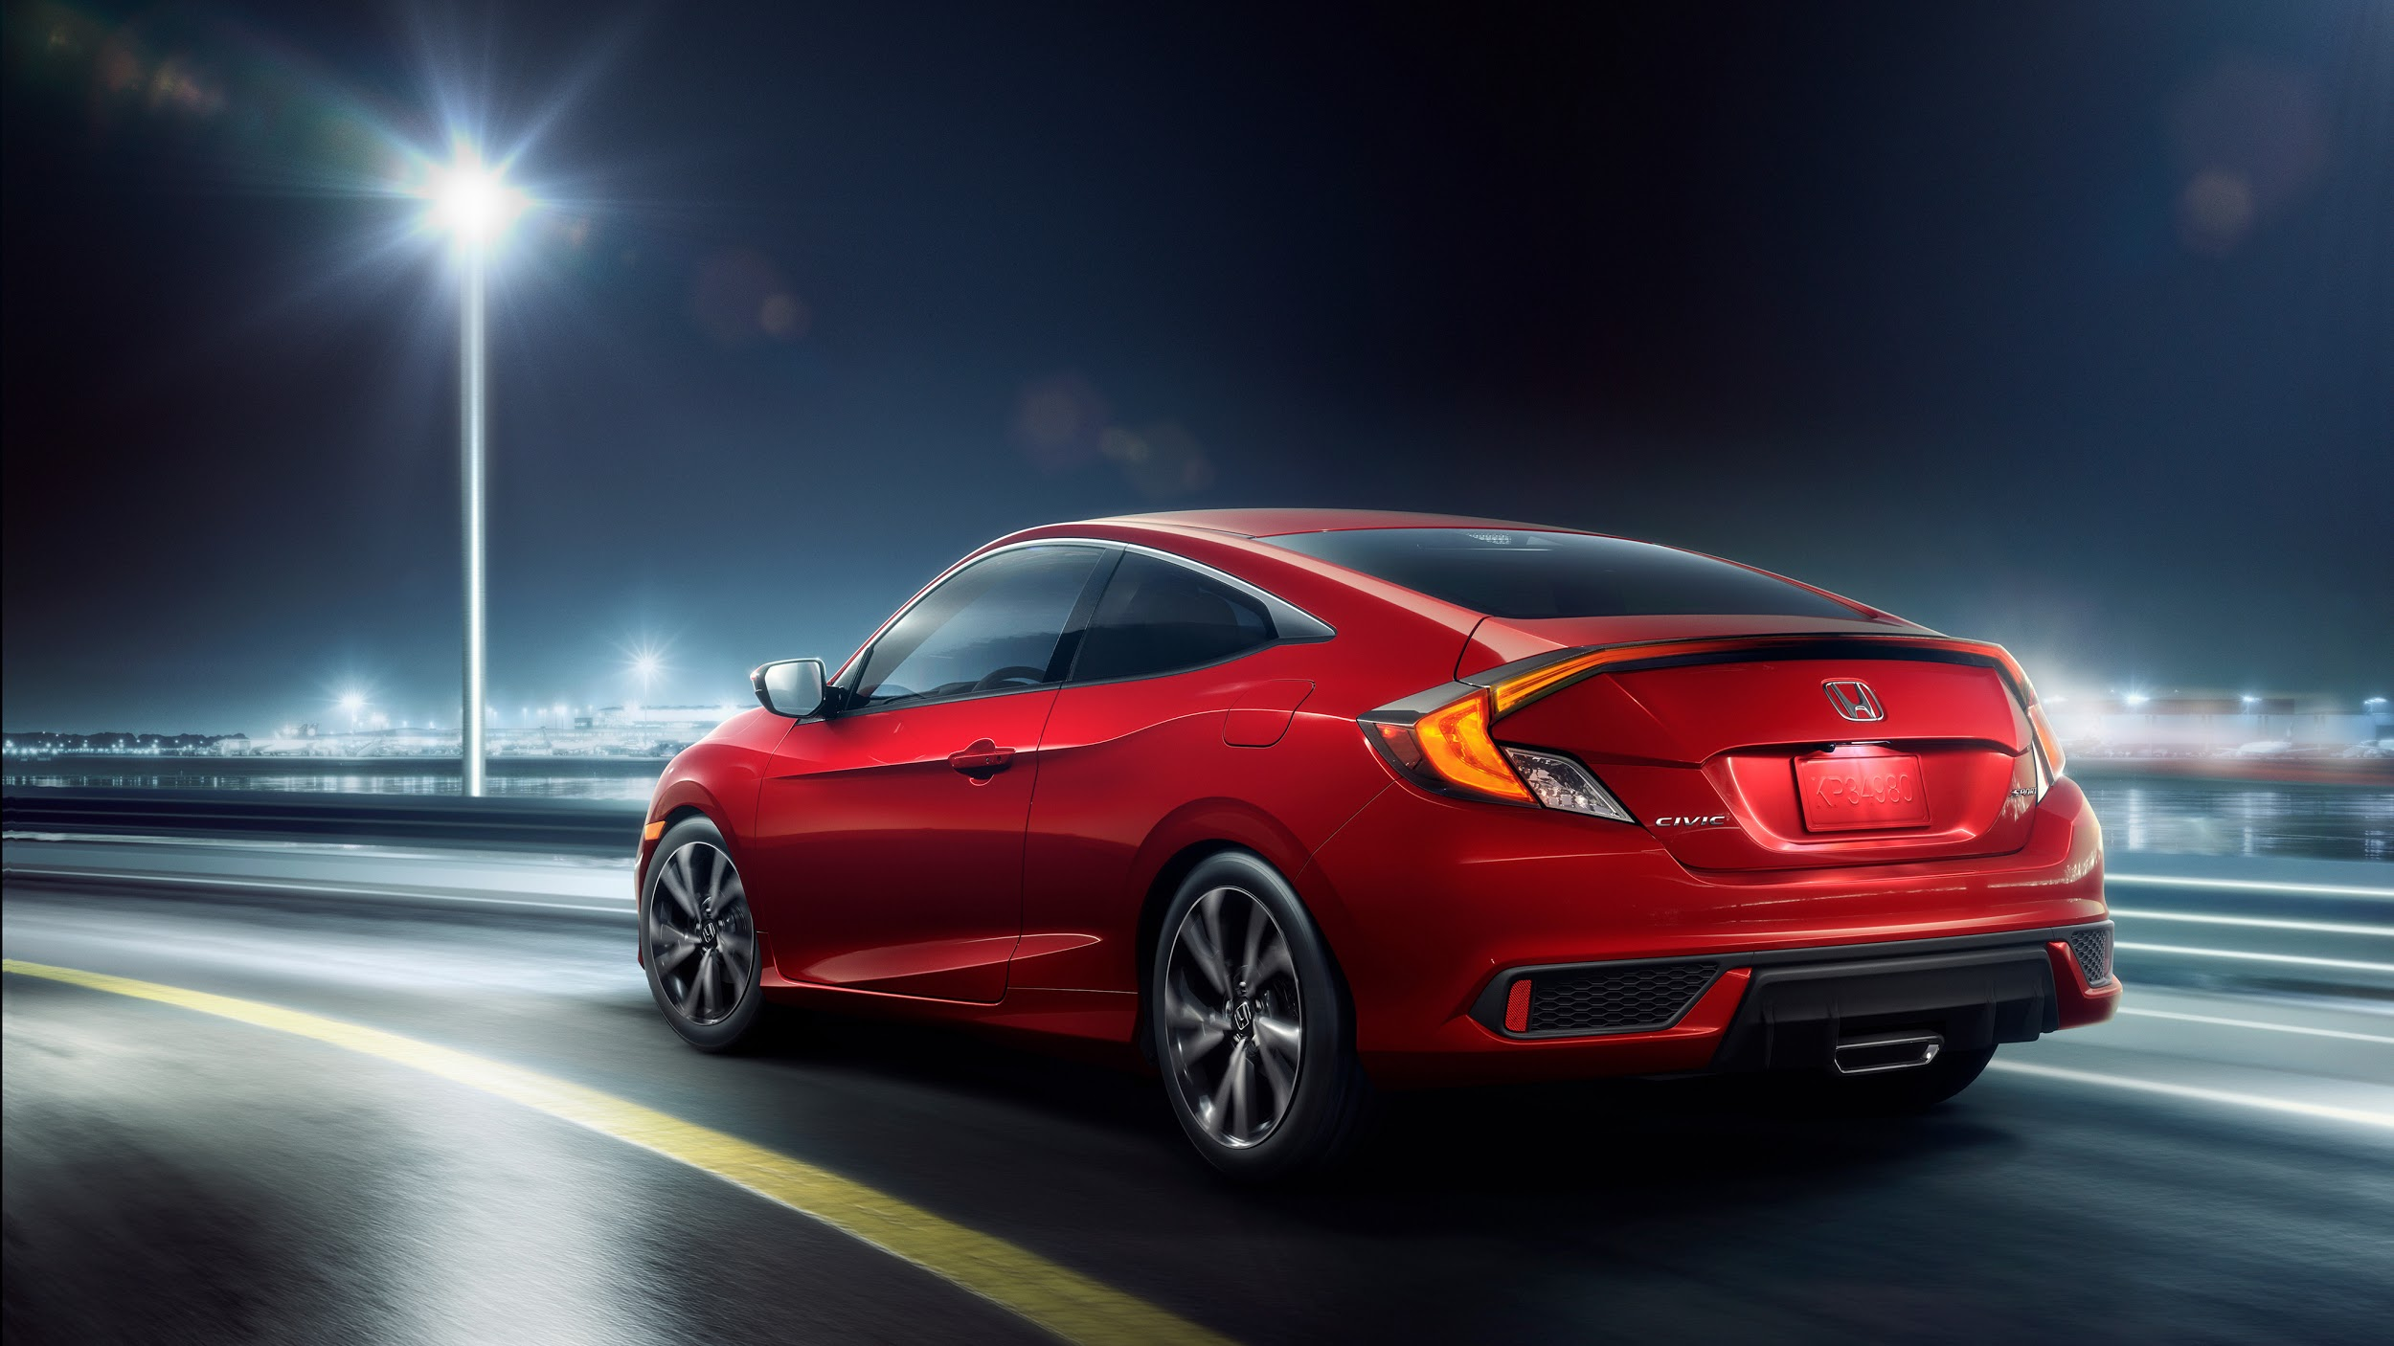
Thank You!!!!!
Notes:
Bri

Slide 18
Questions!
Notes:
Bri

